Slide 1

Acting Like a Designer: Iteration
Chapter 07

Slide 2
Topics
The Iterative Process of Design
Analysis
Design
Implementation
Testing
Iteration!

Slide 3
The Iterative Process of Design
"Game design is 1% inspiration and 99% iteration"
– Chris Swain

Slide 4
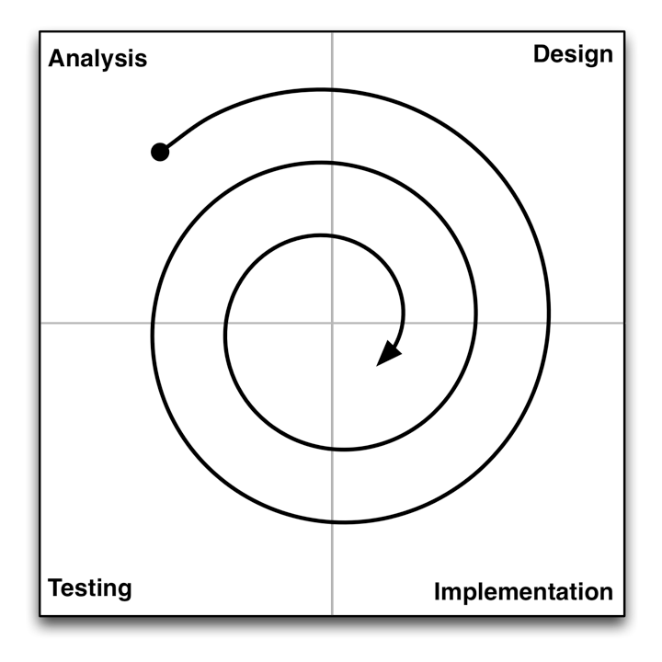
The Iterative Process of Design
Analysis
Understand where you are and what you want to accomplish.
Think about your available resources and time.

Slide 5
The Iterative Process: Analysis
Analysis is about asking the right initial questions:
For whom are you designing this game?
Demographic information.
Target platform.
You're almost never designing the game for yourself!
What are your resources?
Team members, budget, timeline.
Time is the most important resource!
What prior art exists?
What other games exist in this space?
This is often ignored by novice designers, but it's critically important!
What is the fastest path to a playable and testable game?
How can you get your game up and running ASAP?
Mechanics are absolutely the most important element in this phase.

Slide 6
The Iterative Process of Design
Design
Create a design that solves the problem or fits the opportunity.
Starts with brainstorming. Ends with a plan for implementation.

Slide 7
The Iterative Process: Design
This whole book is about design.
This chapter focuses on having the right attitude as a designer.
A lot of design is about having an attitude of listening.
Listen to your audience:
Think about your audience when designing a game.
Listen to their feedback when you get it.
Listen to your team:
Listen to the other people who are working with you.
Especially when they disagree with you
Listen to your client:
If someone is paying you to design a game, you need to listen to them.
This often makes them more likely to pay you and hire you again.

Slide 8
The Iterative Process: Design
A lot of design is about having an attitude of listening:
Listen to your game:
Some brilliant ideas just don't fit in the game you're currently designing.
Save these for later.
Listen to yourself:
Listen to your gut – Sometimes you'll get a gut feeling about something before you consciously figure it out.
Listen to your health – Take care of yourself and stay healthy.
Pulling all-nighters and stressing out decreases your creativity.
Eat well and exercise.
Take breaks when you need to.
Listen to how you sound to other people:
When you say things out loud, think about how you're coming across.
Do you sound respectful?
Do you sound like you care about the other person?
People who demonstrate care and respect for others tend to do better in life, especially in creative fields.

Slide 9
The Iterative Process of Design
Implementation
Execute on your plan. Make a working game prototype.
What is the shortest path to something playable / testable?

Slide 10
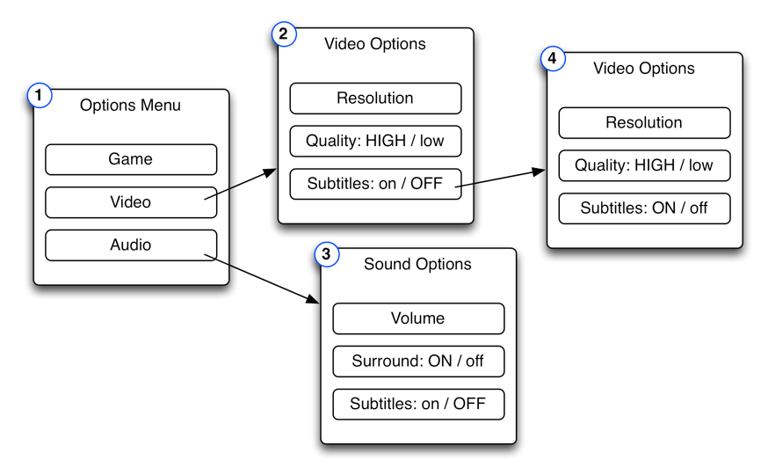
The Iterative Process: Implementation
The goal of implementation is to get from design to testing as quickly and efficiently as possible.
Sometimes you don't even have to make a digital prototype.
For GUI (Graphical User Interface) testing, sometimes a paper prototype will do just fine.
Make pages showing various states of your menu system and test them on people.
This is a paper GUI prototype for asking the player how to turn on subtitles

Slide 11
The Iterative Process: Implementation
The goal of implementation is to get from design to testing as quickly and efficiently as possible.
Sometimes you don't even have to make a digital prototype.
When making digital prototypes, focus on the Mechanics.
The most important thing to test in a digital game is usually the Mechanics.
The Mechanics are also the inscribed element that can't be tested by other means.
The Technology of your prototype will often be replaced by production code in the future.

Slide 12
The Iterative Process of Design
Testing
Have people actually play your game and get reactions!
Testing is critically important to this process!

Slide 13
The Iterative Process: Testing
You won't know anything about your game until someone else plays it.
Because you are the designer, your view of the game is drastically biased.
You need other people to play the game and give you feedback.
People will often try not to hurt your feelings.
Schell recommends saying:
"I need your help.
This game has some real problems, but we’re not sure what they are.
Please, if there is anything at all you don’t like about this game, it will be a great help to me if you let me know."
(Give them permission to tell you the truth.)

Slide 14
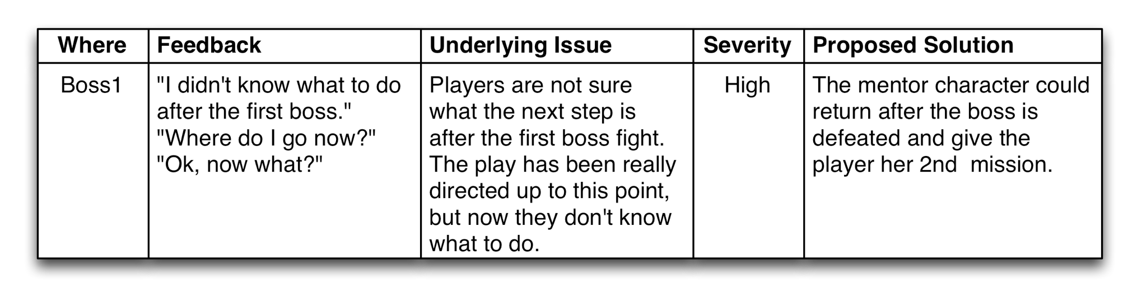
The Iterative Process: Testing
Take good notes!
Where did the comment happen?
What did the playtester actually say?
What do you think she meant?
How severe is the issue?
Not all issues can be fixed.
What is your proposed solution?

Slide 15
The Iterative Process of Design
Iteration!
Analyze the results of your game testing.
Modify your design, implement, test again!

Slide 16
The Iterative Process: Iteration
After testing, analyze the feedback and iterate!
Most games will go through this process many times.
Board game projects at USC were four weeks long.
Week 1: Students are assigned to teams of four people.
Week 2: Students arrive in lab with a playable game.
The game is tested by various players for two hours.
Week 3: Students bring a second iteration of the game to lab.
Week 4: Students bring a third iteration of the game to lab.
Then students had a weekend to finalize the game and turn it in.
Even for a student board game project, we iterated on the game four times before it was turned in.
Digital games take much more iteration!

Slide 17
The Iterative Process of Design

Slide 18
The Iterative Process of Design
Analysis
Understand where you are and what you want to accomplish.
Think about your available resources and time.

Slide 19
The Iterative Process of Design
Design
Create a design that solves the problem or fits the opportunity.
Starts with brainstorming. Ends with a plan for implementation.

Slide 20
The Iterative Process of Design
Implementation
Execute on your plan. Make a working game prototype.
What is the shortest path to something playable / testable?

Slide 21
The Iterative Process of Design
Testing
Have people actually play your game and get reactions!
Testing is critically important to this process!

Slide 22
The Iterative Process of Design
Iteration!
Analyze the results of your game testing.
Modify your design, implement, and test again!

